Slide 1
Motor Sensor Cost Book
Supplier | Allegro | Allegro | Allegro | Allegro | Allegro | AMS | AMS | Infineon | Infineon | TDK | TDK
Part Name | A1331 | A1334 | A1337 | A1338 | A1339 | AS5215 | AS5247 | TLE5009A16D E2210 | TLE5012B DD | TAS4601 | ATAS2001
Communication | SPI | SPI | SPI | SPI | ABI / SPI | Analog | ABI / SPI | Analog | IIF / SPI (3 wire) | Analog | Digital
Package | TSSOP | TSSOP | TSSOP | TSSOP | TSSOP | QFN | TQFP | TDSO | TDSO | VSOP | TBD
# of dies | 2 | 2 | 2 | 2 | 2 | 2 | 2 | 2 | 2 | 2 | 2
Die Orientation | Side-by-side | Side-by-side | Side-by-side | Side-by-side | Stacked | Stacked | Stacked | Stacked | Stacked | Stacked | Stacked
Integrated TC | Y | N | Y | N | Y | N | N | N | N | N | N
Status | Production | Production | Pre-Production | Pre-Production | First Samples | Production | Pre-Production | Production | Production | Production | Development
Chip Cost | $2.249 | $1.428 | $1.996 | $1.465 | $1.976 | $1.446 | $1.730 | $1.320 | $2.200 | RFQ Out | TBD
Shunt Ring | Y | Y | Y | Y | Y | N | N | Y | Y | Y | Y
Shunt Ring Cost | $0.280 | $0.280 | $0.280 | $0.280 | $0.280 | $0.000 | $0.000 | $0.280 | $0.280 | $0.280 | $0.280
Total Cost | $2.529 | $1.708 | $2.276 | $1.745 | $2.256 | $1.446 | $1.730 | $1.600 | $2.480 | #VALUE! | #VALUE!
TC Option | Internal | External ICs | Internal | External ICs | Internal | External ICs | External ICs | PIC & Polling w/ BEMF Wakeup | PIC & Polling w/ BEMF Wakeup | PIC & Polling | PIC & Polling
TC Cost | $0.000 | $2.088 | $0.000 | $2.088 | $0.000 | $2.088 | $2.088 | $1.000 | $1.000 | $0.850 | $0.850
Total Cost w/ TC | $2.529 | $3.796 | $2.276 | $3.833 | $2.256 | $3.534 | $3.818 | $2.600 | $3.480 | #VALUE! | #VALUE!
External TC
IC | Allegro A1319 (2x)
IC cost | 1.138
Processor | Microchip PIC16LF1847
Processor Cost | 0.5
Regulator | TI LM2936
Regulator Cost | 0.3
Other Components | Diodes, R, C
Other Cost | 0.15
Total Sub Cost | 2.088
Magnet Information
Size (magnet/shaft) | Cost
6/10 | $0.678
8/10 | $0.775
8/12 | $0.870
10/12 | $0.972

Slide 2
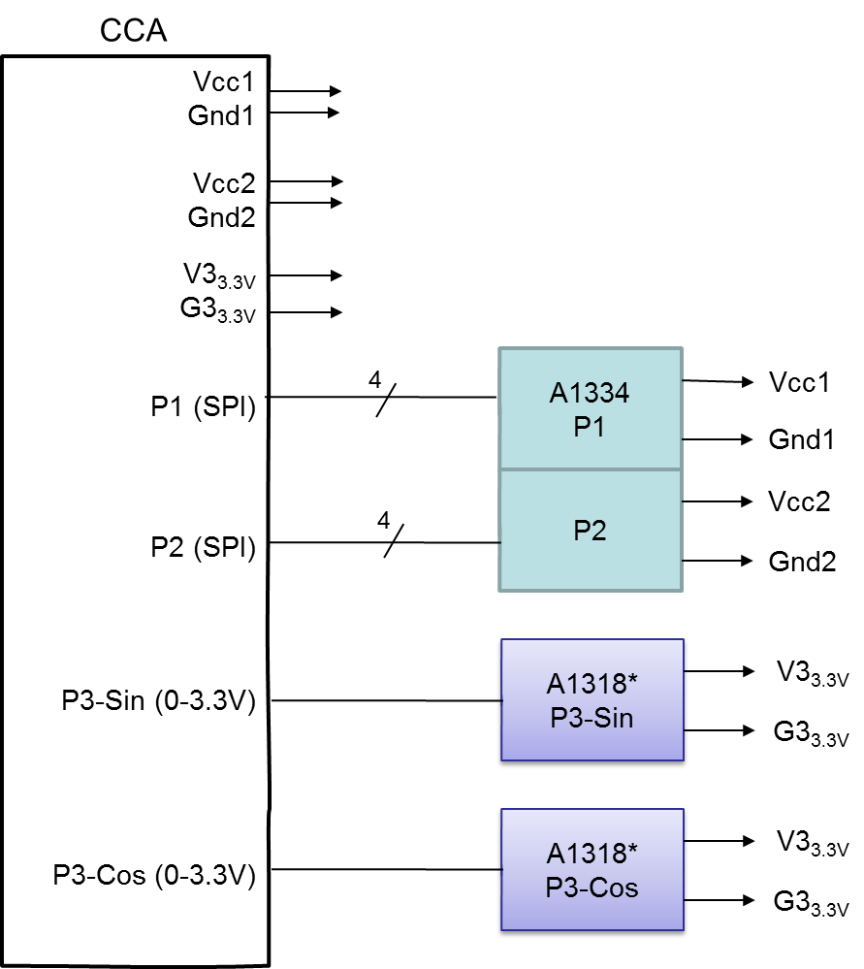
Example: T1xx
Content:
Tertiary redundant motor position sensor
No turns counter
Integrated into CCA
Digital communication (SPI) primary,
analog redundant
Cost
A1334 | $1.428
A1318 (2x) | $1.138
10mm Magnet | $0.972
Shunt Shield | $0.28
Total | $3.818

Slide 3
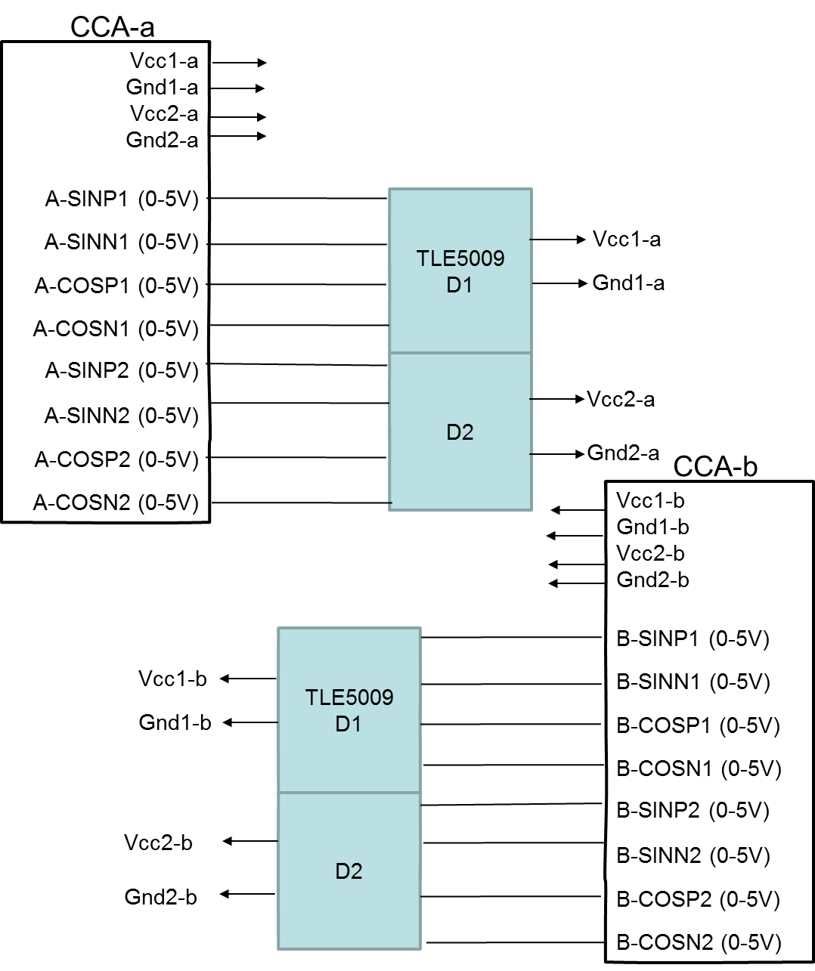
Example: Ford 391 (Ford ADAS)
Content:
Fully redundant system: two CCAs,
four motor position sensors
No turns counter
Integrated into CCA
Analog communication
Cost
TLE5009 (2x) | $2.64
10mm Magnet | $0.972
Shunt Shield | $0.28
Total | $3.892
Digital Solution - FYI
Cost
TLE5012 (2x) | $4.4
10mm Magnet | $0.972
Shunt Shield | $0.28
Total | $5.652

